Slide 1
EXPENSE ANALYSIS
Analysing monthly expenses to identify the top categories of expense and providing the recommendations to improve savings for Nitin.
RAVALI

Slide 2
June month expenses on different items of each category

Slide 3
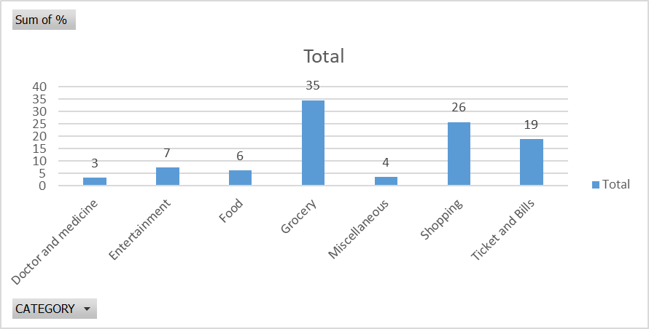
Amount spent on each category in %

Slide 4
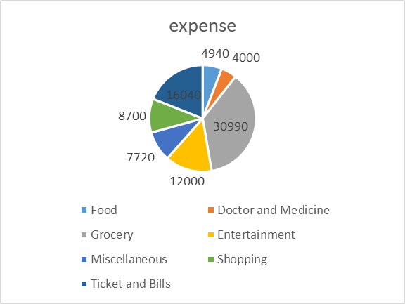
Category wise expenses for 6 months

Slide 5
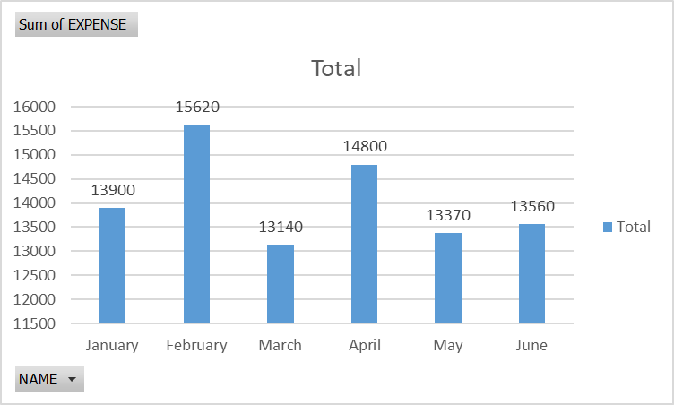
Month wise expenses of Nitin

Slide 6
Representation of expenses using data bars for June month and 6 months

Slide 7
Findings from the tables and charts
In June month Nithin spent more grocery.
Nithin has spent more for shopping which is not essential in June.
Food expenses are high for June month.
Overall for the 6 months Nithin spent more for entertainment , shopping and miscellaneous than recommended.
In February he spent highest amount for all categories.
In march he spent less amount compared to other months.
For Grocery he spent the maximum in 6 months.

Slide 8
Recommendations to increase savings
Reduce spending on less essential categories like movies , online food order instead he can watch movies in OTT and cook at home.
He has spent more for shopping, to reduce it he can plan quarterly purchase of clothes.
And also he can plan trips once in 6 months or a year so that he can save more.
Set a fixed monthly budget plan by focusing essential expenses.
By cutting down the expenses of less essential things, nitin can increase his savings 20-30%, so that he can buy a scooter for his daily commute to the office like he planned.
Use savings for investment and emergencies.

Slide 9
conclusion
Food and entertainment are top expense categories of Nitin.
Spending on non essential items is high and affects savings.
By reducing less essential expenses, Nitin can improve his savings.

